Slide 1
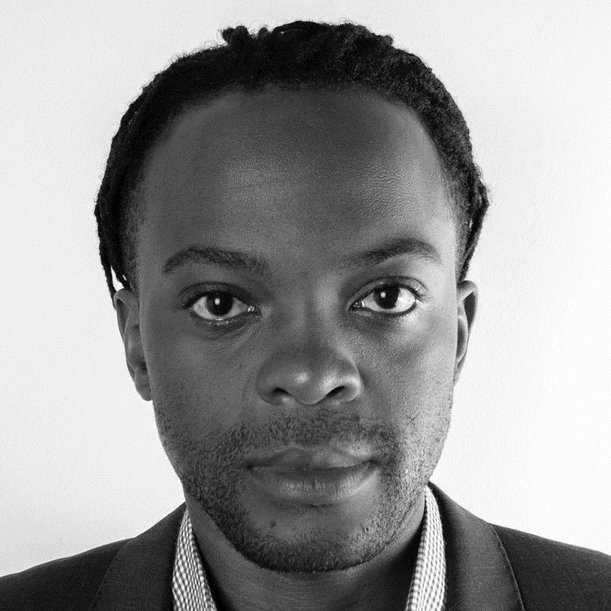
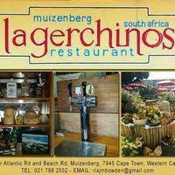






Marco Lulu Mulasi Mulaj
Personality
Marco is an ambitious person who has developed a mature and responsible approach to any task that I undertake, or situation that I am presented with. As I acquired a concrete three years’ of experiencing management skills, communication skills, and so on, I am excellent in working with others to achieve a certain objective on time and with excellence
I am very passionate with new technology and always willing to learn more as I have the ability to learn very quick. I like using the creativity side of me where, I impressed my environment with art, design, dance, adviser and so on. I am confident that I am the right piece of puzzle that will fit the future successful picture of your company
Industries
Restauration
Marco has proved his ability to socialize, communication and sale and the restauration services and he has deliver well appreciated attention and service to all customer with a noticeable satisfaction from different restaurants and bars that he was employed to (e.g. Lagerchinos (2009-2010), Ferdinandos Pizza (2015-2017), Knead (2017)
Construction
In this field of theories and practice building and structure; Marco has been involve intellectually (studied at Cape Peninsula University of Technology¹ and at University of Cape Town¹) and practically where by he worked for EMPA structure¹ , one of a highly reputed company in Cape Town
Publishing
Marco worked for PixelFaerie¹ (German Company based in Cape Town) as a desktop publisher. He gained the experience of visualizing data information graphically on presented document, e.g. Powerpoint presentation, Gant/timeline development, and so on
Civil construction manager/ Entrepreneur
South Africa (Cape Town, Western Cape)
Work Experience
Marco has worked in diverse industries:
Restauration Industries: 4 years
Construction Industries: 3 years
Publishing Industries: 5 years
1. Please find attached document has support for this information

Slide 2
Construction Management
Marco Mulasi Lulu Mulaj
Cape Peninsula University of Technology

Slide 3
Construction Management
Marco Mulasi Lulu Mulaj
University of Cape Town

Slide 4
Construction Management
Marco Mulasi Lulu Mulaj
EMPA Structure

